Slide 1
PIV with Light Field Microscopy
Light field microscopy is a useful tool that allows microscopists to collect three-dimensional information about a scene in a single snapshot.
Combine Light field microscopy with PIV, 3D velocity filed information can be conducted from two snapshots.
------------------------------Liu Hong

Slide 2
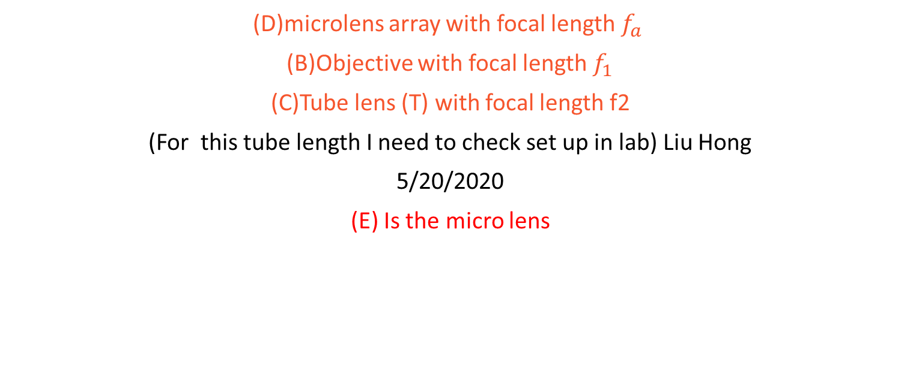
Important components in a light field microscopy system.
(D)microlens array with focal length $f_{a}$
(B)Objective with focal length $f_{1}$
(C)Tube lens (T) with focal length f2
(For this tube length I need to check set up in lab) Liu Hong
5/20/2020
(E) Is the micro lens

Slide 3
Design Plan
Decide smallest feature you are going to capture
(5 micro meter)
cannot push this feature size too small, or you will lose the ability to refocus due to the diffraction limit
2. choose an objective with the highest NA for largest FOV.

Slide 4
if we want to image five-micron neurons using a 40X objective, we should have a microlens pitch equal to 5X40=200 micron at the largest; 100 micron pitch microlenses would be preferable.
Microlens focus length calculation 40X/1.3NA oil objective will create rays that at most hit the intermediate image plane at a $\theta_{max} = \sin^{-1}(1.3/40) = 1.86$ degree angle. Let us suppose we went with 100 micron microlenses. In order to have the circles abut, we want a ray from the center of the microlens stray 50 microns from the optical axis at a distance from the microlens equal to the focal length. Thus, we can solve for the focal length to be: $ f = 50 / \tan(\theta_{max}) = 1540$ microns. it's okay to have the focal length be shorter than the ideal.

Slide 5
Our microlens data information:
MLA-S125-f30
Focal length =
30 * 125 micro meter = 3750 micro meter
Based on our objective information
10X/0.3NA
Theta = sin^(-1)(0.3/10) = 0.03
f = 125/tan(0.03)= 4165 micro meter
I think it is good, because it is close to 3750
Micro meter. A little bit shorter is fine.

Slide 6
Calibration
1. adjust camera sensor to imaging the bacl focal plane of microlens array.

Slide 7
2. Align microlens array to the intermediate image plane

Slide 8
Finally, We can use LFDisplay to reconstruct the image,
Then apply Gaussian blob detection to find the particle in multi depth, apply the PTV particle tracking to find the velocity filed.

Slide 9
End

Slide 10
Old document just for refocusing testing about the software and coding.

Slide 11
1. Import 2. Microlens Calibration, 3. Radiance Array Formation 4. Computational Imaging

Slide 12
Import
calibration image
plenoptic image
magnification at the nominal focal plane(focal length of the main lens)
focal length of the microlens array
(Just pick one or choose other camera, then we need
the technical information of that microlens)

Slide 13
Microlens calibration
determine the center of each microimage

Slide 14
Radiance array formation
from the raw plenoptic image into a 4D radiance array
(u, v, s, t) coordinates
The(u, v) coordinates are associated with the angular data, and the (s, t) coordinates are associated with the spatial data.

Slide 15
A is the aperture;
1. Perspective shifts (Optional)
2. Refocusing
Objective distance
Multi micro
lens get the light

Slide 16
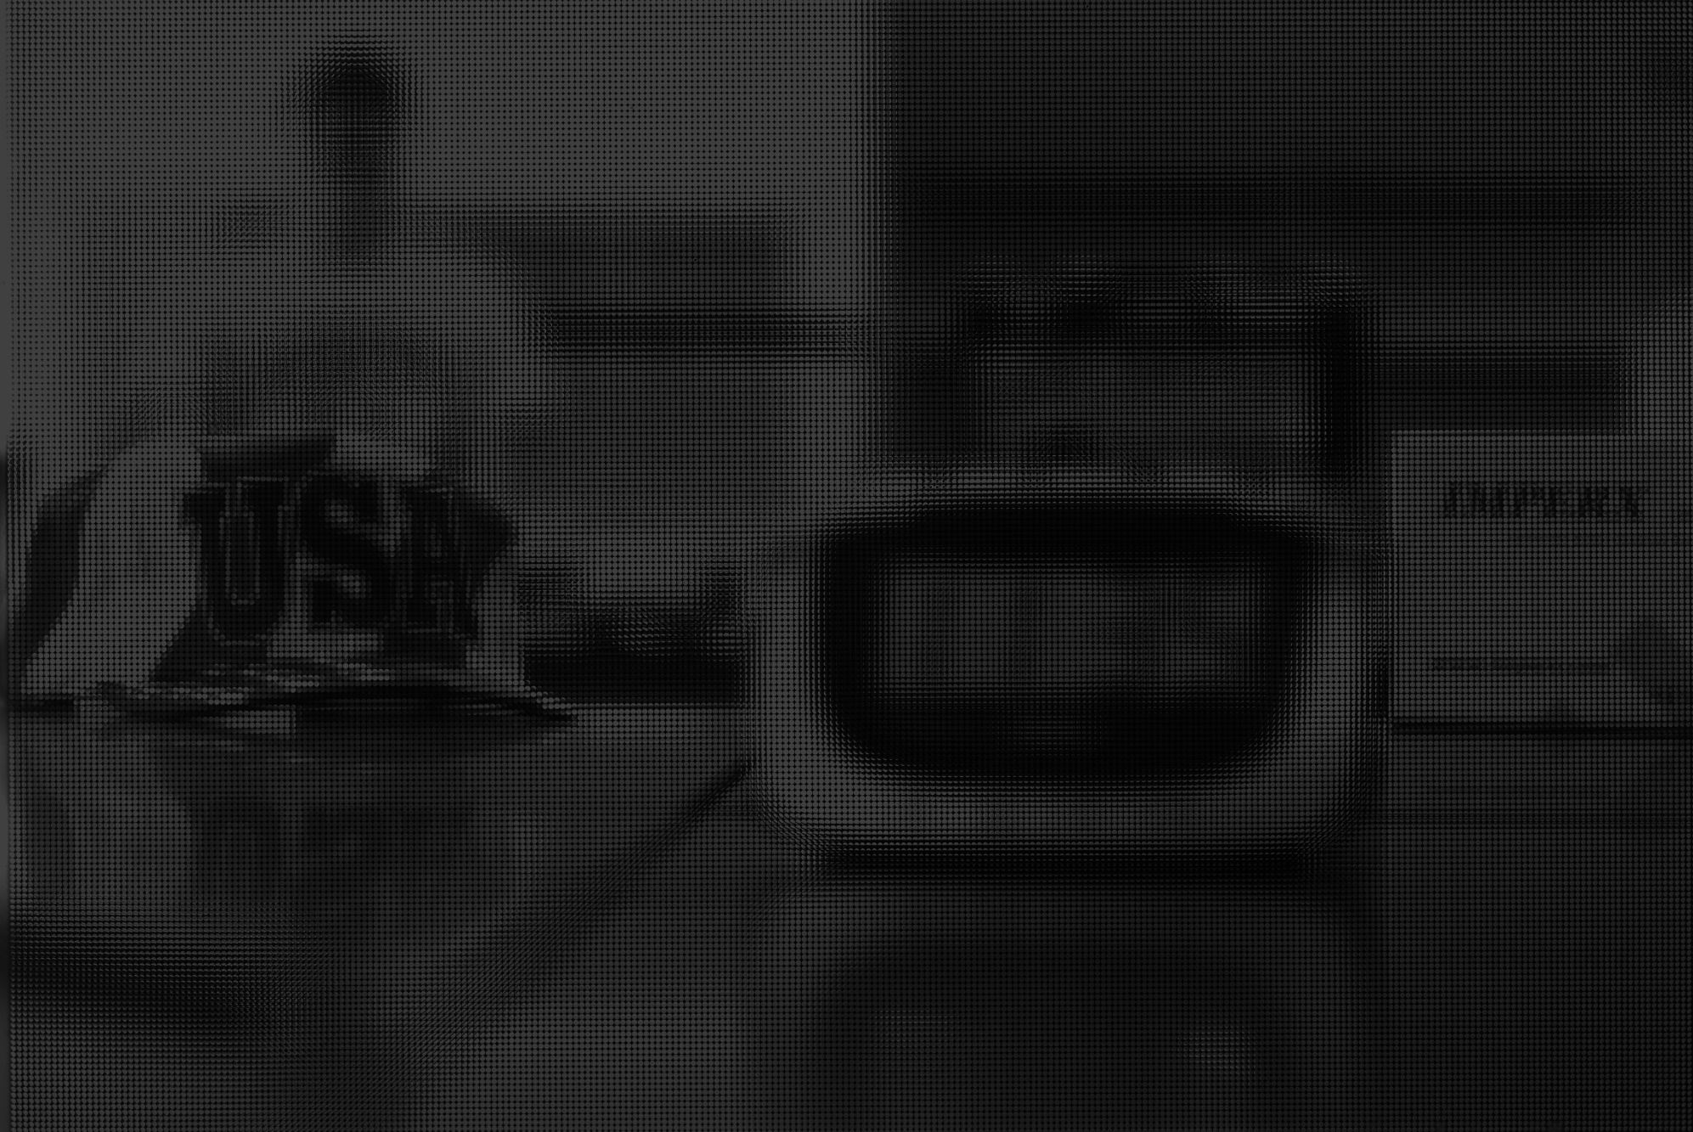
Calibration Image
There are multi white dots, but they are too small to see
Raw Image

Slide 17
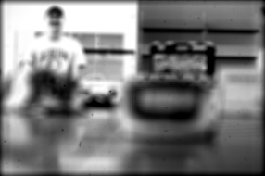
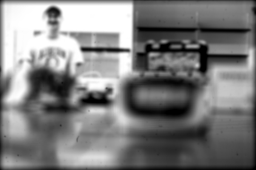
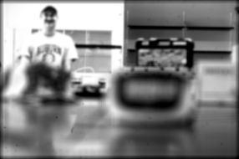
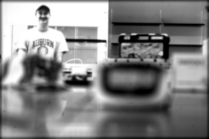
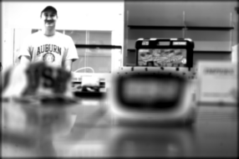
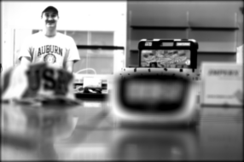
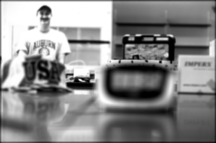
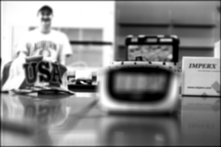
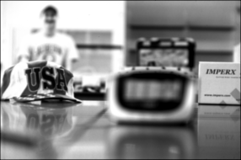
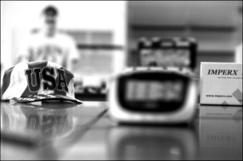
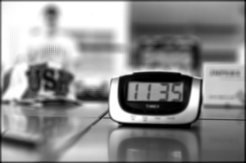

Result

Slide 18
Long focus distance test: large DOV 50 CM

Slide 21
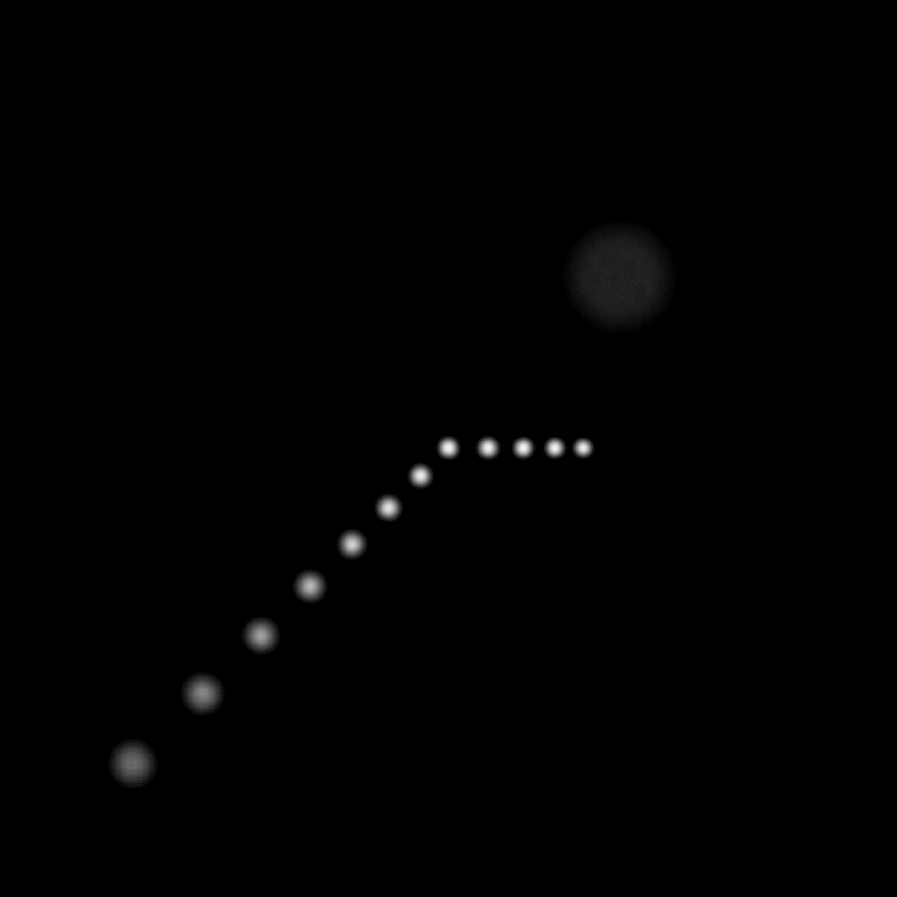

Slide 22

Mart/ Sart Method
$$Ax=b$$
A is the weigh matrix, b is 2D image, x is 3D space information.
For our case, b is 3000x3000 resolution matrix.
X is 200 x 200 x 100 matrix, but A the weight matrix is 3.6e+13. It is sparse, should be some way to improve.
We can’t do this

Slide 23
3D deconvolve

Slide 24
Short focus test: 5cm x 10 cm x 10 cm

Slide 25
100 micro meter particle

Slide 26
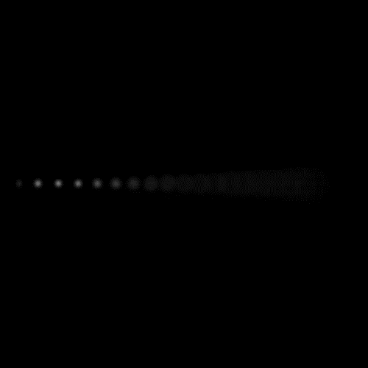
20mm/50 = 0.4mm
26 * 0.4 -0.1 = 10.3 mm
25mm -25mm
100 frame stack linear from -25mm to 25mm
Resolution:
400 x 400 x 100
Sacrifice x-y resolution to get z resolution
100 micro meter particle

